Slide 1
CALENDAR SAN FRANCISQUITO
IVAN VELASQUEZ

Slide 2
January
D SUNDAY | L MONDAY | M TUESDAY | M WEDNESDAY | J THURSDAY | V FRIDAY | S SATURDAY
 |  | 1 ONE | 2TWO | 3THREE | 4FOR | 5FIVE
6SIX | 7SEVEN | 8EIGHT | 9NINE | 10TEN | 11ELEVEN | 12 TWELVE
13THIRTEEN | 14FOURTEEN | 15fifteen | 16SIXTEEN | 17 SEVENTEEN | 18EIGHTEEN | 19NINETEEN
20 TWENTY | 21 TWENTYONE | 22 TWENTYTWO | 23 TWENTYTHREE | 24 TWENTYFOR | 25 TWENTYFIVE | 26 TWENTYSIX
27 TWENTYSEVEN | 28 TWENTYEIGHT | 29 TWENTYNINE | 30THIRTY | 31THIRTYONE

Slide 3
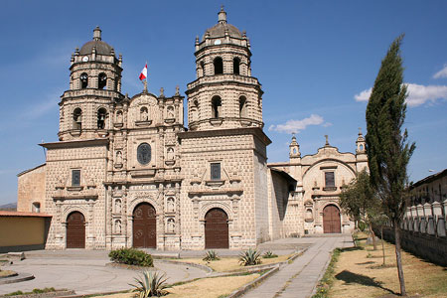
CHURCH OF SAN FRANCISQUITO
THE CHURCH OF SAN FRANCISQUITO IS A HISTORICAL HERITAGE FOR ITS ARCHITECTURAL DESIGN IN STONE

Slide 4
February
D SUNDAY | L MONDAY | M TUESDAY | M WEDNESDAY | J THURSDAY | V FRIDAY | S SATURDAY
 |  |  |  |  | 1 ONE | 2 TWO
3 THREE | 4 FOR | 5 FIVE | 6 SIX | 7 SEVEN | 8 EIGHT | 9 NINE
10 TEN | 11 ELEVEN | 12TWELVE | 13 THIRTEEN | 14FOURTEEN | 15FIFTEEN | 16SISTEEN
17SEVENTEEN | 18EIGHTEEN | 19NINETEEN | 20TWENTY | 21TWENTYONE | 22TWENTYTWO | 23TWENTYTHREE
24TWENTYFOR | 25TWENTYFIVE | 26TWENTYSIX | 27TWENTYSEVEN | 28TWENTYEIGHT

Slide 5
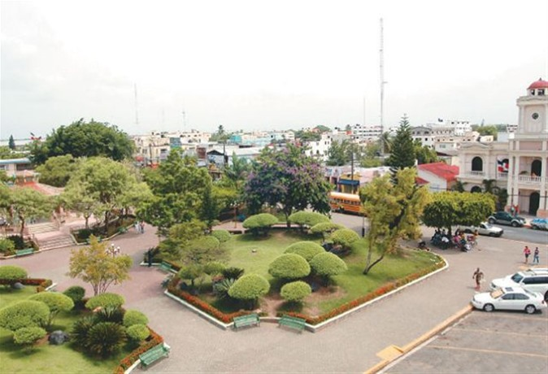
CENTRAL PARK OF SAN FRANCISQUITO
the san francisquito central park has a greater attraction that is the enchanted park which attracts the attention of tourists

Slide 6
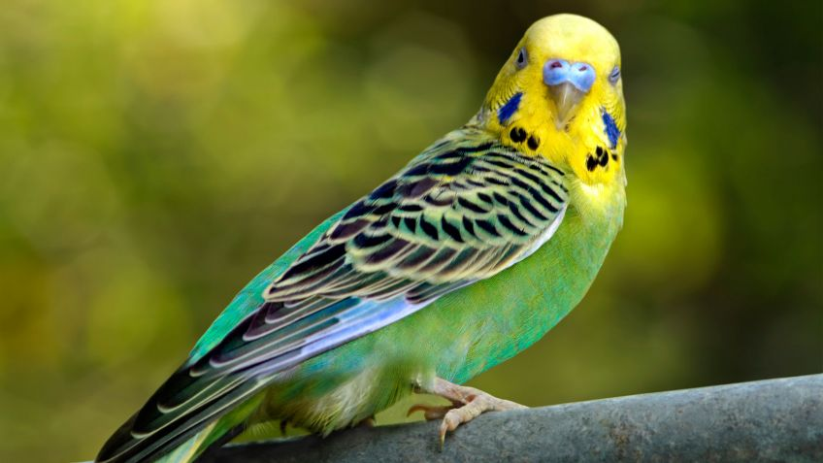
the common parakeet

Slide 7
the common parakeet
The common parakeet is a flying animal. It is a small bird and its weight oscillates 35 grams. On the other hand, considering its size, it has big wings, since they measure about 10 cm. their life span ranges between 5 and 10 years

